Slide 1


Sales Forecasting Models for Direct Selling Business:
A Data-Driven Approach to Predictive Analytics
PREPARED BY : SIVARAJAN ESVARAN – MSC241051

Slide 2


PREPARED BY :
SIVARAJAN ESVARAN
MCS241051
Master in Data Science Student
ASSOC. PROF. DR. MOHD SHAHIZAN BIN OTHMAN
Lecturer
University Teknologi Malaysia

Slide 3

TABLE OF CONTENTS
Background Study
Problem Statement
Research Question and Objective
Scope of Study
Literature Review Research
Methodology
Data Collection Method
Data Cleaning Process
Exploratory Data Analysis
Initial Finding & Result
Feature Engineering
Key Business Insights
Summary
Future Work

Slide 4

BACKGROUND STUDY
The direct selling industry, valued at USD 175.19 billion in 2024 and projected to reach USD 207.36 billion by 2034 Direct Selling Overview in 2024: Thriving Industry | MLM Trend org, faces significant operational challenges that hinder business growth and strategic planning Independent distributors in direct selling companies encounter particularly difficult circumstances in anticipating future sales performance due to highly unpredictable consumer demand patterns, seasonal fluctuations, and complex customer relationship dynamics. Individual distributors typically rely on intuitive decision-making rather than data-driven forecasting models and leading to missed sales opportunities. While predictive analytics have brought tremendous success to retail and e-commerce industries, the direct selling sector, particularly at the individual distributor level, has been slow to adopt advanced forecasting technologies, creating a critical gap between available analytical capabilities and practical business applications that this research aims to address.

Slide 5
PROBLEM STATEMENT
LACK OF ADVANCED FORECASTING TOOLS
Independent distributors in direct selling companies do not have access to sophisticated sales forecasting models that can predict future performance and guide strategic business decisions.
SUBOPTIMAL BUSINESS OPERATIONS
Without accurate forecasting capabilities, distributors face inefficient inventory management, missed sales opportunities, and poor planning for promotions.
COMPLEX SALES DYNAMICS
The direct selling environment presents unique forecasting challenges due to highly variable consumer demand, seasonal fluctuations, customer lifecycle changes, product launches, and economic factors.
STRATEGIC DECISION-MAKING LIMITATIONS
Distributors struggle to set achievable targets, plan promotional activities, and make informed decisions about market segment development.

Slide 6
RESEARCH QUESTIONS & OBJECTIVES
RESEARCH QUESTIONS
What are the dominant temporal patterns in direct selling transactions, and how do seasonal variations affect sales forecasting accuracy across different time horizons?
How do traditional statistical models (ARIMA) compare to machine learning approaches (LSTM, Random Forest, Linear Regression) in terms of forecasting performance for direct selling businesses with highly variable sales patterns?
What factors contribute to the superior performance of ARIMA models in achieving acceptable forecasting criteria compared to machine learning approaches in this specific business context?
How can the identified customer demographics patterns and purchasing behaviours be leveraged to improve sales forecasting models?
RESEARCH OBJECTIVES
To conduct comprehensive exploratory data analysis
To analyse temporal sales patterns
To develop and implement multiple forecasting models
To establish comprehensive model evaluation criteria
To identify optimal forecasting approaches

Slide 7

SCOPE OF STUDY
Data Source and Timeframe
The study utilizes detailed transaction and customer data from a single Amway distributor which provides granular insights into customer purchasing patterns, product performance, and sales trends for developing robust forecasting models.
Forecasting Model Development The research implements and compares four distinct forecasting approaches to ensures comprehensive evaluation of different forecasting methodologies suitable for direct selling business contexts.
01
02
Multiple Prediction Horizons
The study develops forecasting systems capable of predictions across representative time scales to meet different business planning requirements from short-term operational decisions to long-term strategic planning.
Technology Stack and Deployment Considerations
The research focuses on Python-based model development using scikit-learn, TensorFlow/Keras, and specialized forecasting libraries like Prophet and statsmodels.
04
03

Slide 8

LITERATURE REVIEW
DIRECT SELLING INDUSTRY CHARACTERISTICS AND CHALLENGES
The literature examines the unique operational challenges faced by direct selling organizations, particularly those functioning within network marketing relationships like Amway.
SALES FORECASTING MODELS AND METHODOLOGIES
The literature review covers the evolution of forecasting approaches from traditional statistical models (ARIMA, exponential smoothing, Bass diffusion models) to modern machine learning techniques (LSTM, Random Forest, SVM).
CUSTOMER SEGMENTATION AND BEHAVIORAL ANALYSIS
Studies highlight the importance of customer profiling and segmentation using advanced techniques like RFM analysis (Recency, Frequency, Monetary) combined with clustering algorithms.

Slide 9
LITERATURE REVIEW
Author / Year | Title | Research Focus | Machine Learning Methods
Liu et al. (2023) | A combination model based on multi-angle feature extraction and sentiment analysis: Application to EVs sales forecasting | Developing a hybrid forecasting model integrating multi-angle feature extraction and sentiment analysis for electric vehicle sales prediction | MEMD decomposition, Sentiment analysis, Combination forecasting
Elalem et al. (2023) | A machine learning-based framework for forecasting sales of new products with short life cycles using deep neural networks | Forecasting sales of new short life cycle products using deep learning and ARIMAX with cluster-based data augmentation | ARIMAX, LSTM, GRU, CNN
Yan et al. (2025) | A novel sales forecast framework based on separate feature extraction and reconciliation under hierarchical constraint | Hierarchical sales forecasting with separate feature extraction and reconciliation to improve supply chain planning | LSTM (for time-dependent features), MLP (for static features)

Slide 10
LITERATURE REVIEW
Author / Year | Title | Research Focus | Machine Learning Methods
Liu et al. (2025) | An electric vehicle sales hybrid forecasting method based on improved sentiment analysis model and secondary decomposition | Combining sentiment analysis and secondary decomposition for electric vehicle sales forecasting | BERT-BiLSTM sentiment analysis, decomposition + ML hybrid
Wu et al. (2023) | Bayesian non-parametric method for decision support: Forecasting online product sales | Developing PoissonGP, a Bayesian non-parametric model for online sales forecasting with uncertainty quantification | Poisson Gaussian Process (PoissonGP)
Rahman et al. (2025) | Enhancing sustainable supply chain forecasting using machine learning for sales prediction | Using ML algorithms to improve demand prediction and supply chain decision-making | Linear Regression, Elastic Net, KNN, Random Forest, Voting Regressor

Slide 11
LITERATURE REVIEW
Author / Year | Title | Research Focus | Machine Learning Methods
Hu et al. (2025) | Grid-based market sales forecasting for retail businesses using automated machine learning and geospatial intelligence | Combining AutoML and geospatial intelligence for grid-level market sales forecasting and site selection | AutoML, regression models
Shao et al. (2025) | New energy vehicles sales forecasting using machine learning: The role of media sentiment | Integrating media sentiment indices into machine learning models for NEV sales forecasting | ML models with sentiment analysis (exact algorithms not detailed but includes ML hybrid models)

Slide 12
LITERATURE REVIEW
RESEARCH GAP
Spatial and Geographic Limitations
Limited Direct Selling Analytics
Inadequate Time-Horizon Analysis
Multi-Modal Data Integration Gap
SOLUTION
Comprehensive Forecasting Framework
Data-Driven Decision Making Tools
Practical Business Application
Scalable Analytics Platform

Slide 13
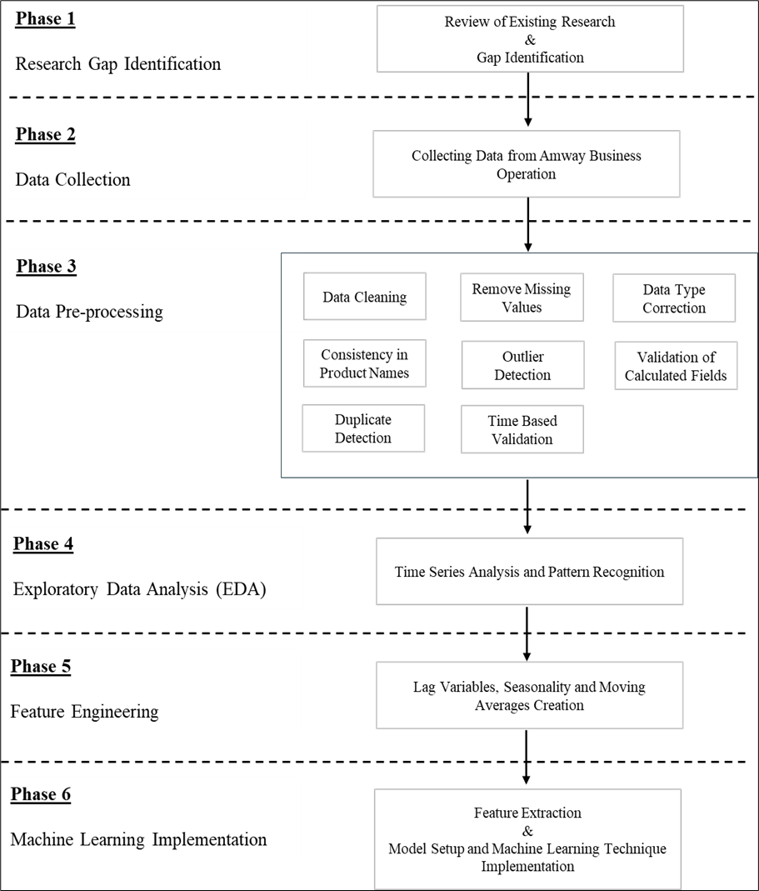
RESEARCH METHODOLOGY
The framework for this research includes the following stages:
Identifying the Research Problem and Reviewing Existing Literature.
Data Collection from Amway Business Operations.
Preprocessing the Data: Preparing and cleaning data for detailed analytical tasks
Exploratory Data Analysis (EDA): Time Series Analysis and Pattern Recognition
Sales Forecasting Models: Implementing multiple forecasting algorithms (Linear Regression, Random Forest, LSTM and ARIMA)
Model Evaluation: Comparing model performance using forecasting evaluation metrics.

Slide 14


DATA COLLECTION METHOD
The data collection process involved acquiring actual sales transaction data from a single Amway distributor covering a 24-month period from April 2023 to April 2025. The primary data source consisted of monthly PDF sales reports downloaded directly from the official distributor portal. To facilitate analysis and model building, a systematic Python-based conversion methodology was implemented to transform these PDF files into structured CSV format. The conversion process utilized specialized Python libraries (pandas, PyPDF2, tabula, pdfplumber) for PDF data extraction and processing

Slide 15
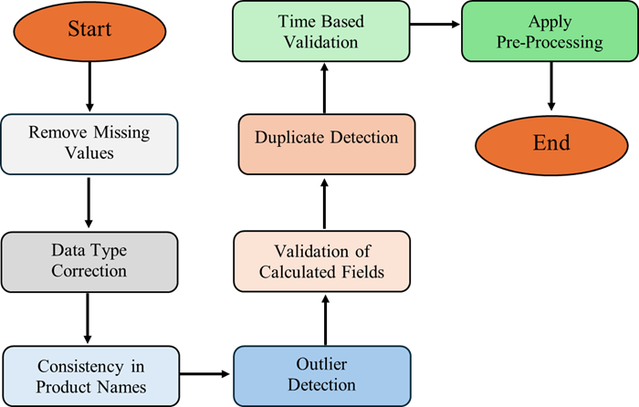
DATA CLEANING PROCESS
Data cleaning is a vital process in sales forecasting to ensure the dataset is accurate, consistent, and ready for machine learning models. The comprehensive cleaning pipeline involved removing missing values, correcting data types, standardizing product names, detecting outliers using statistical methods, validating calculated fields, and eliminating duplicate transactions.
Data Cleaning Process

Slide 16
EXPLORATORY DATA ANALYSIS
Exploratory Data Analysis (EDA) serves as the foundation for identifying temporal patterns, key business insights, and customer behaviors that directly influence sales performance in direct selling environments. The EDA process systematically explores relationships, underlying patterns, and dataset characteristics before model development, focusing on two critical components:
Time Series Analysis
Time series analysis identifies temporal patterns such as trends, seasonality, and cyclical behaviors through time series decomposition, separating underlying trends from seasonal variations and random noise to provide insights into long-term business growth patterns and recurring seasonal effects.
Pattern Recognition Analysis
Pattern recognition analysis encompasses customer behaviour evaluation, product performance assessment, and geographic market analysis to identify actionable business intelligence, including RFM analysis (Recency, Frequency, Monetary) for customer segmentation, cross-selling pattern identification, and regional market performance analysis that reveals opportunities for business expansion and optimization

Slide 17
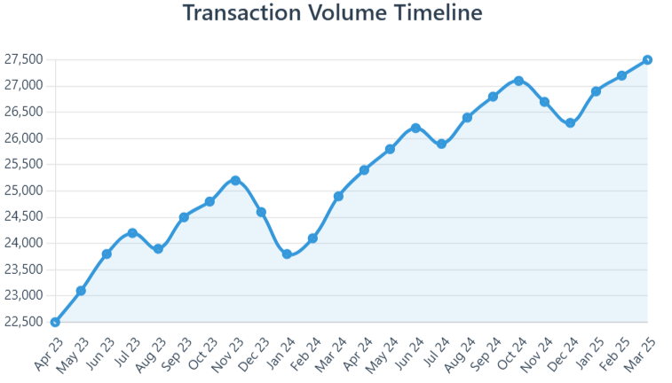
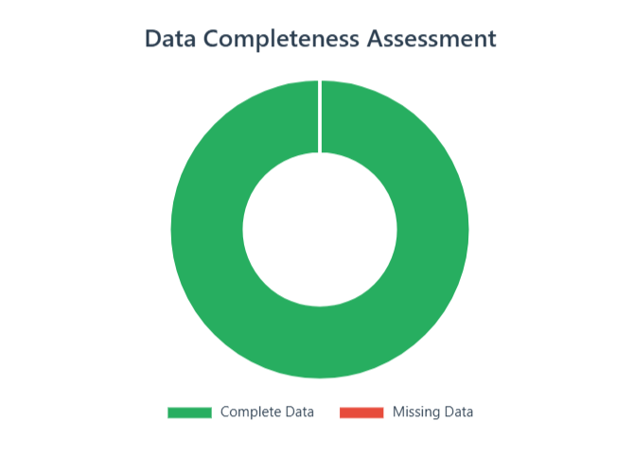
INITIAL FINDING & RESULT
The research demonstrates exceptional data quality and substantial business scale, providing a robust foundation for comprehensive sales forecasting analysis. The dataset encompasses 553,542 real-world transactions collected over a 24-month period from April 2023 to April 2025, achieving remarkable 100% data completeness across all 12 core features with no missing values identified during the quality assessment process. This pristine data quality is particularly notable in direct selling business analytics, where complete and accurate transaction records are often challenging to obtain. The substantial scale of the dataset is further emphasized by the total sales volume of RM 335.8 million generated during the study period, with an average transaction value of RM 606.31, demonstrating significant business impact and commercial relevance.

Slide 18
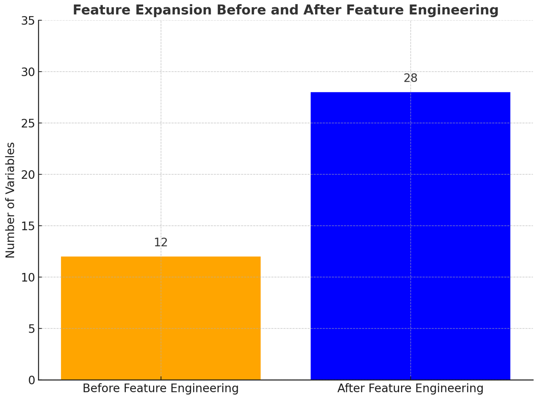
FEATURE ENGINEERING
The feature engineering process successfully expanded the dataset from 12 to 28 variables through systematic enhancement, creating temporal features (seasonality, trends), behavioral indicators (customer loyalty metrics), pricing indicators (cost ratios), and purchase recency measures. This 133% feature increase provided a robust foundation for developing powerful, accurate sales forecasting models.

Slide 19
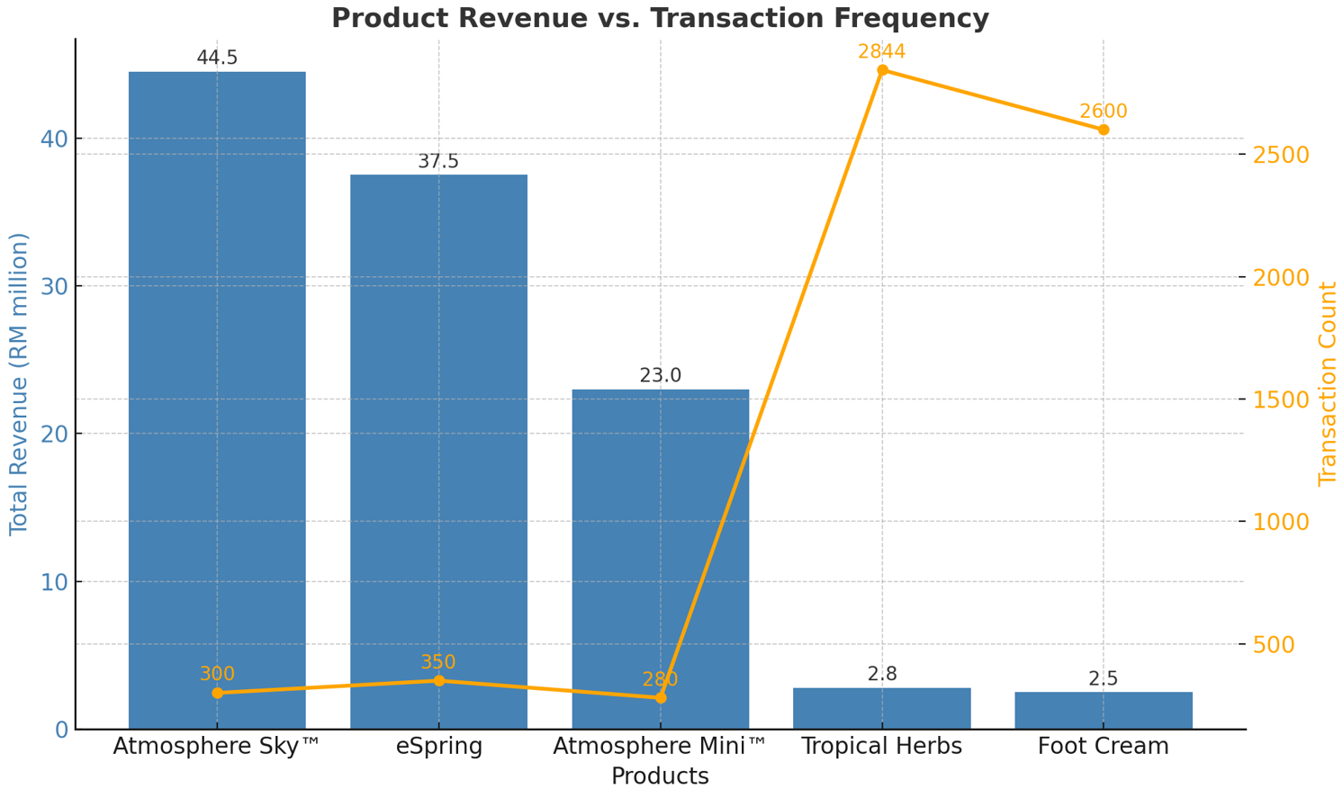
KEY BUSINESS INSIGHTS
The analysis revealed significant business insights including product performance disparities where Atmosphere Sky™ generated RM 44.5 million in revenue despite lower transaction frequency, while consumables led in transaction volume. Customer demographics showed a mature base averaging 47.8 years with substantial purchasing power reflected in RM 606.31 average transactions, demonstrating clear revenue concentration patterns.

Slide 20
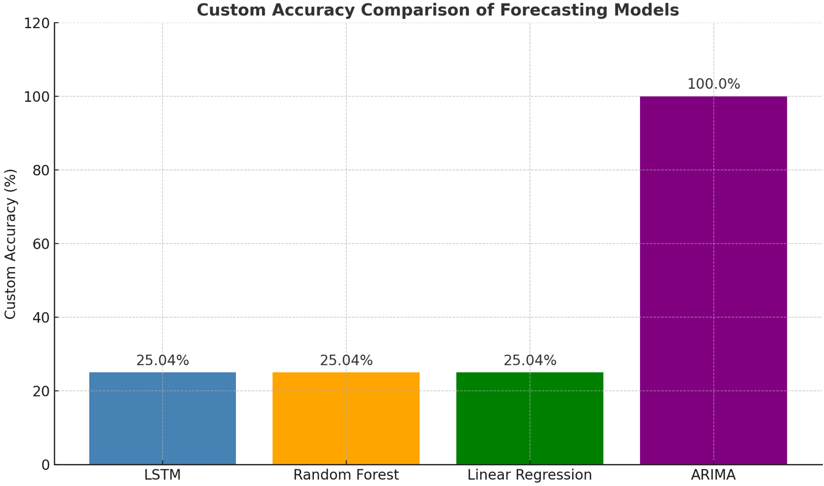
MACHINE LEARNING MODEL ACCURACY
Model evaluation revealed unexpected results where LSTM, Random Forest, and Linear Regression achieved identical performance with R² = 0.964 but critically high MAPE = 52.68% and only 25.04% custom accuracy, severely limiting practical utility. ARIMA demonstrated paradoxical performance with negative R² (-0.106) yet achieved 100% custom accuracy, highlighting that high explanatory power doesn't guarantee business forecasting utility.

Slide 21
SUMMARY
Research
Research Achievement and Dataset Quality
Successfully analyzed 553,542 transactions over 24 months with 100% completeness, generating RM 335.8 million in real Amway sales data.
Critical Model Performance Insights
High R² (0.964) didn't guarantee business utility with 52.68% MAPE. Only 25.04% predictions met acceptable accuracy thresholds.
01
03
Comprehensive Forecasting Model Development
Implemented four forecasting approaches (LSTM, Random Forest, Linear Regression, ARIMA) and expanded features from 12 to 28 variables systematically.
Business Impact and Future Research Directions
Revealed gap between statistical success and practical utility, establishing framework for democratizing analytics in direct selling businesses.
02
04

Slide 22
FUTURE WORK
Model Architecture Refinement and Optimization
Investigate advanced LSTM architectures with attention mechanisms, ensemble techniques, and address potential data leakage issues for improved performance.
Enhanced Evaluation Framework Development
Resolve ARIMA performance contradictions through detailed methodological reviews, cross-validation methods, and business-sensitive scoring measures for operations.
Customer-Level Predictive Analytics Expansion
Develop individual customer behavior models predicting lifetime value, purchase propensity, and product preferences for enhanced relationship management.
Real-Time Integration and Automation Systems
Enable automated model retraining pipelines, live dashboard monitoring, geographic analysis, and scalable deployment for comprehensive business intelligence.

Slide 23
- THANK YOU -

